Slide 1
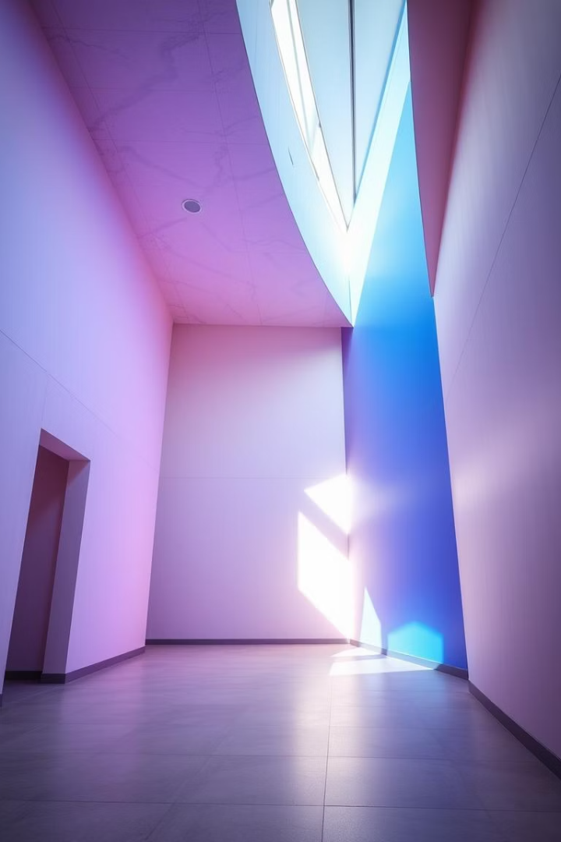

Drywall Pannels: The Versatile Building Material
Discover the adaptable uses and benefits of gypsum board in construction.
This material combines ease of installation with durability and design flexibility.

Slide 2
What is Drywall Panels and How is it Made?
Gypsum board is made from a gypsum core sandwiched between paper sheets.
This efficient production ensures consistent quality and performance of the panels.
The manufacturing process includes mixing, shaping, drying, and cutting boards.
Visualising this process helps understand its precision and industrial scale.

Slide 3
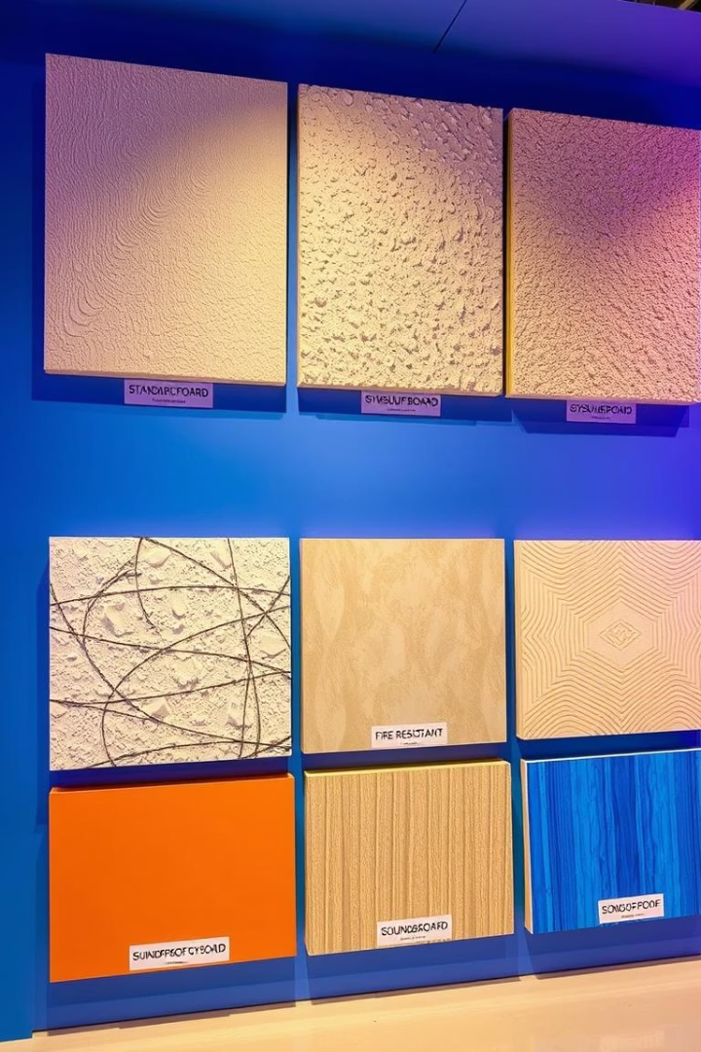
Types of Gypsum Board: A Visual Guide to Applications
Standard Board
Used for general wall and ceiling applications.
Moisture-Resistant Board
Ideal for kitchens and bathrooms.
Fire-Resistant Board
Designed for enhanced safety in critical areas.
Soundproof Board
Reduces noise transmission between rooms.

Slide 4
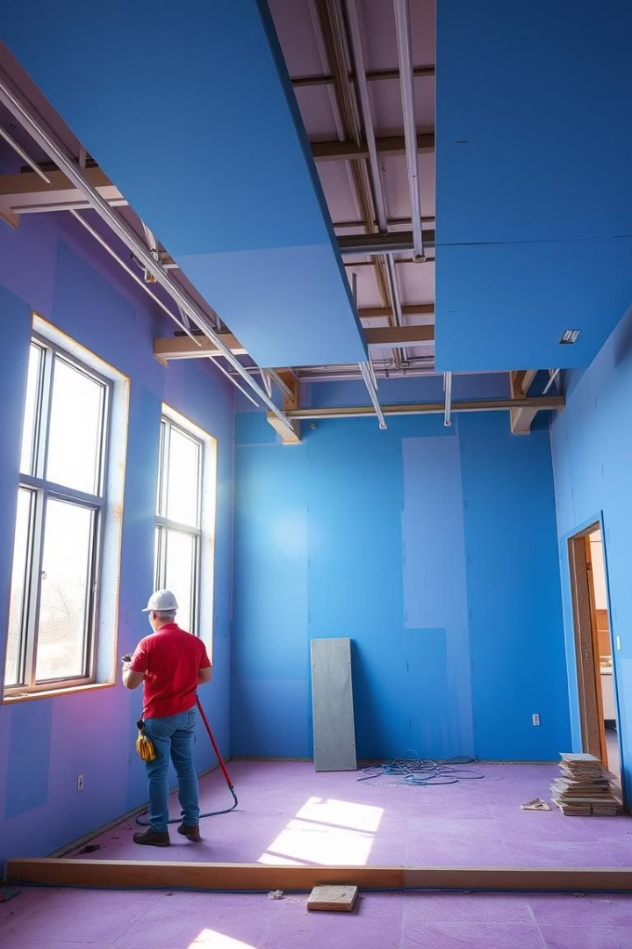
The Benefits of Using Gypsum Board: A Cost-Effective Solution
Fast Installation
Speeds up construction time with lightweight panels.
Low Material Costs
Affordable compared to traditional plaster or masonry.
Clean Finish
Ensures smooth surfaces ready for decoration.
Versatile Design
Supports curves, angles, and creative architectural features.

Slide 5
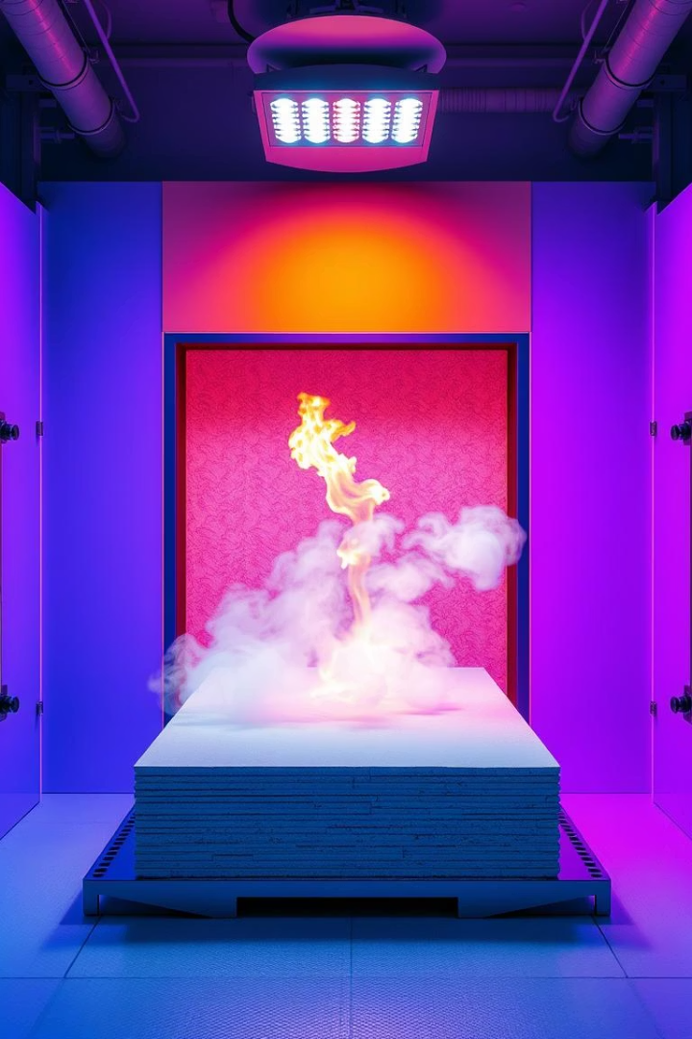



Fire Resistance and Acoustic Performance
Fire Resistance
Gypsum boards delay fire spread, enhancing building safety.
Sound Insulation
Effective at dampening noise, ideal for shared spaces.
Building Codes
Meets strict regulations for fire and acoustic performance.

Slide 6
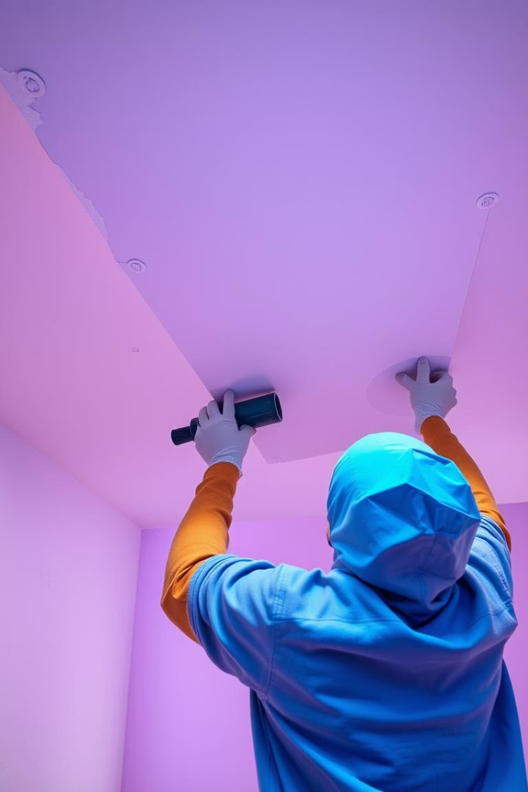
Installation Best Practices: A Step-by-Step Guide
Surface Preparation
Ensure walls and frames are clean and level.
Board Fixing
Use correct screws and fix panels securely to framing.
Joint Taping and Finishing
Apply tape and compound for smooth, invisible joints.
Sanding and Painting
Prepare surface for desired finish or decoration.

Slide 7
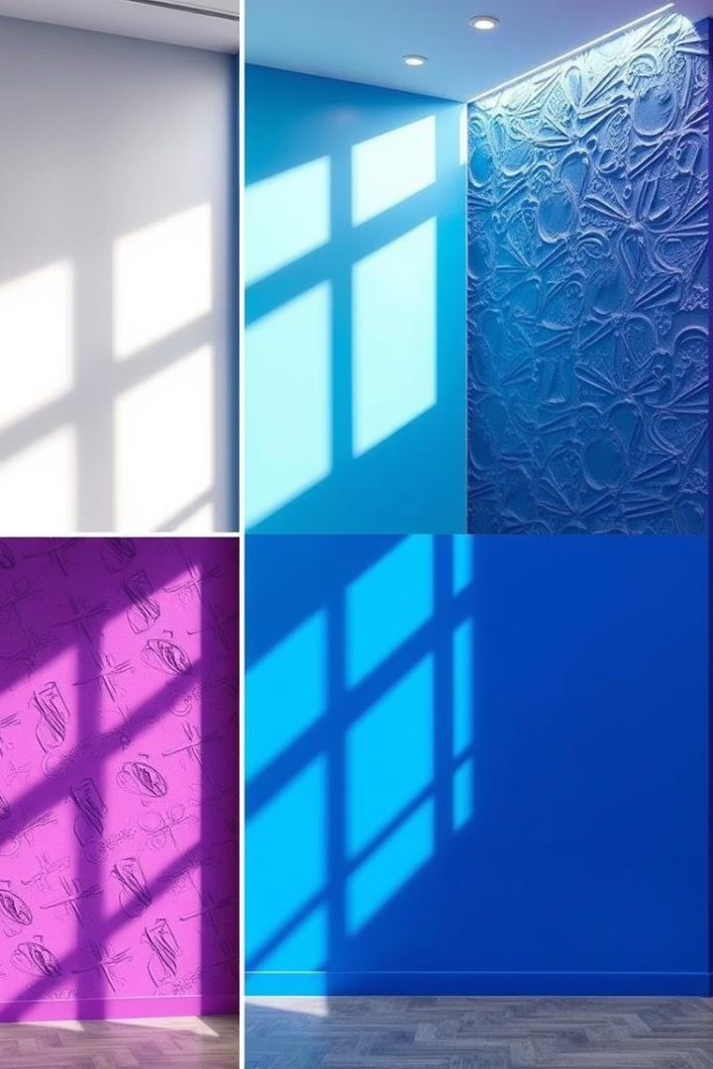
Gypsum Board Finishes: Achieving the Perfect Look
Painted
Simple and widely used for a clean finish.
Textured
Adds depth with patterns or plaster effects.
Wallpapered
Allows for varied design styles and colours.
Decorative Panels
Incorporates mouldings or artistic detailing.

Slide 8
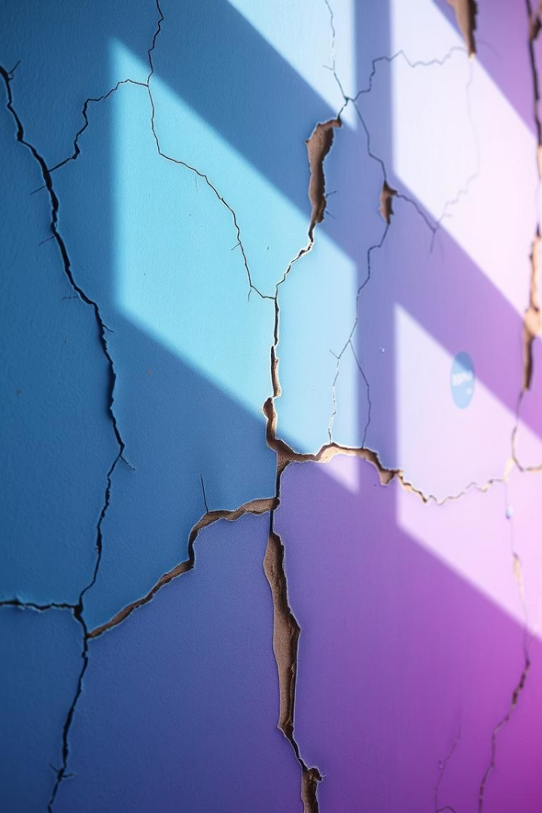
Common Problems and Solutions
1
Cracking
2
Water Damage
Caused by structural movement; use flexible joint compounds.
Replace affected boards; use moisture-resistant types.
3
Improper Fastening
Ensure screws are flush and appropriately spaced.

Slide 9
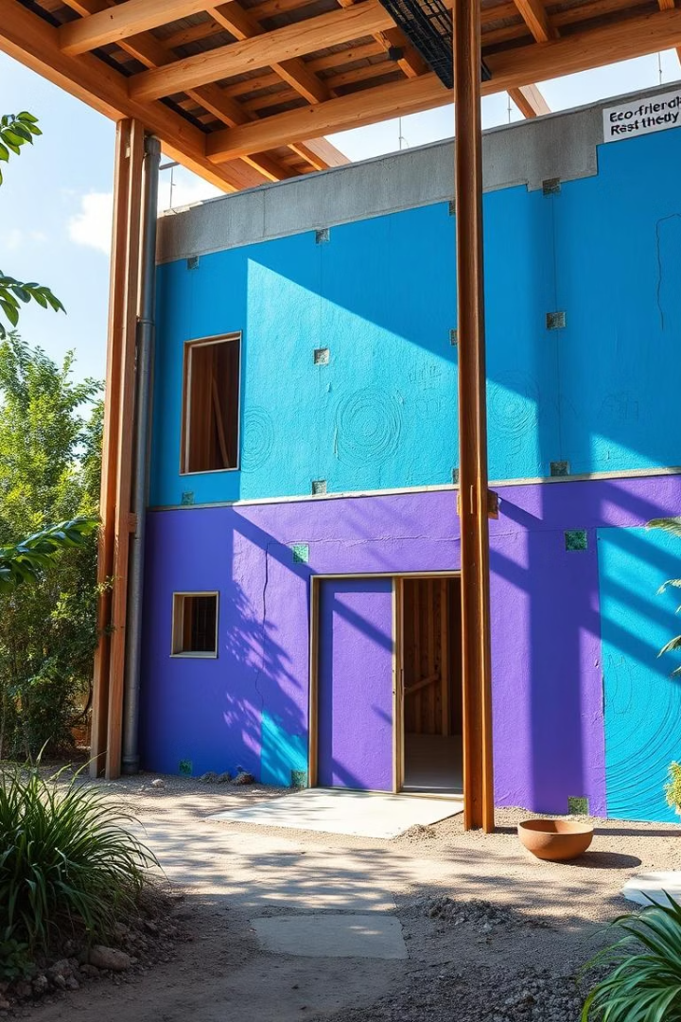
Sustainable Building with Gypsum Board
Gypsum board is recyclable and often contains recycled material.
Its lightweight nature reduces transport emissions, supporting green building.
Energy-efficient in thermal insulation, it cuts heating and cooling costs.

Slide 10
Conclusion: Why Drywall Panels are the Right Choice
Gypsum board offers flexibility, affordability, and performance.
Ideal for residential, commercial, and sustainable projects alike.
It meets safety standards while enabling creative designs.
Choosing gypsum board ensures quicker builds and lasting quality.

